Slide 1














Who Is
DESCO INDUSTRIES INC?
© 2023 DESCO INDUSTRIES INC
Employee Owned

Slide 2

Outline
Corporate Brands
History of DESCO INDUSTRIES INC
Market
Product Lines
Sales & Distribution Structure
Strategic Issues in Sales & Marketing
DescoIndustries.com

Slide 3








DESCO INDUSTRIES INC
Full Service ESD Solutions and Packaging
Full Service ESD Solutions
ESD Process Control Solutions
European Full Service ESD Solutions
Specialty Tools
Products for rework and repair in electronics assembly
Precision Hand Cutting Tools and Pliers, Wire Strippers and Tweezers
Hand Tools
ESD Packaging Solutions
Asian Sell Focus
ESD Flooring Solutions
Clean Room Assembly and Packaging
Manufacturing outsourcing services and engineering support and design
AC and DC Fans and Blowers and Related Accessories
Convection Rework Machines

Slide 4
Net Sales - Brand % Pie
STATGUARD FLOORING
2%
SPECIALTEAM
2%
DESCO Asia
3%
APR
1%
Protektive Pak
4%
MENDA
8%
SCS
36%
Desco Europe
8%
proNet
8%
DESCO
27%
DescoIndustries.com

Slide 5

Historical Overview
Desco Industries Incorporated in 1979.
Started as a specialty tools manufacturer
Specialized in circuit tracers and solder aids
Background in distribution set the initial strategy
Desco launches distribution strategy
Desco hires first reps
DescoIndustries.com

Slide 6
Opportunity Knocks
1982 - Desco starts manufacturing static control products - private label
1984 - Desco enters static control market with wrist straps and ground cords
1985 - Desco adds matting products
Static control becomes primary revenue generator
DESCO INDUSTRIES INC begins roll-up strategy in static control market place
DescoIndustries.com

Slide 7

Pieces Fall Into Place
1988 - Control Static - Ionization, Test Equipment
1990 - Charleswater - Packaging, Floor Finish, Foot Grounders
1995 - Plastic Systems - Complementary direct sales channel
1998: Conductive Products - European distribution/sales
1999: Wescorp - ESD Tape line
1999: Pilgrim - Continuous monitor/tester offering
DescoIndustries.com

Slide 8
Acquisitions
2000: MENDA - Specialty Tools brand/platform
2002: Protektive Pak - ESD and Electronics Packaging
2003: Semtronics - High Electronics
2004: SPI - Room Ionization Process Ionization, new customer base
2007: Vermason – Expand European presence & market share
2008: CVinyl – RF Sealing of custom vinyl products
2013: SpecialTeam Medical Services – Contract assembly and packaging facility that provides expertise in cleanroom processing and manufacturing systems.
2015: SCS - assets of 3M’s Static Control business
2017: EasyBraid – Equipment used in the PCB assembly industry
DescoIndustries.com

Slide 9
Acquisitions
2018: US Toyo Fan – AC and DC fans and blowers and related accessories,
such as finger guards, filters, and fan cords
2018: APR – Convection rework machines used to remove and install
complex surface mounted devices
2019: Tronex - Precision hand cutting tools and pliers preferred by users in
sectors including electronics manufacturing, medical device
manufacturing and jewelry making.
2021: Beau Tech - Hand tools relating to the repair, rework, R&D, testing and
assembly of electronic components and printed circuit boards.
2022: Statico - A supplier of Static Control and Cleanroom products.
      March – Purchase WickGun
2023: proNet - Manufacturing outsourcing services and engineering support
and design products.
DII steps up its drive to buy market share and expand its solutions/offering and customer base.

Slide 10

Annual Revenue - 2022
$78,300,000
DescoIndustries.com

Slide 11
Recent Acquisitions
Beau Tech, acquired in 2021 and offered under the MENDA brand, is a US hand tools manufacturer that provides quality tools including MilProbes, Soldering Aids and Spudgers for applications relating to the repair, rework, R&D, testing and assembly of electronic components and printed circuit boards.
Statico, acquired in 2022 and offered under the ESD Systems brand, is a supplier of Static Control and Cleanroom products.
proNet acquired in August 2023. proNet is an ISO 9001 certified company that provides manufacturing outsourcing services and engineering support and design.
DescoIndustries.com

Slide 12
Organization
DII
Desco
Distribution
(ESD Focus)
SCS
Distribution
(ESD/Packaging)
Desco Europe
European
Distribution
(ESD Focus)
MENDA/
EasyBraid/
Tronex/
Beau Tech
Distribution
(Diversification)
Protektive Pak
Packaging
Channel
SpecialTeam
Cleanroom
Assembly
and
Packaging
Desco Asia
Asia
Distribution
Statguard
Flooring
Flooring
Dealers
(ESD Flooring
Solutions)
APR
Convection
Rework
US Toyo Fan
Distribution
(Thermal
Management)
proNet
Manufacturing
outsourcing
services and
engineering
support
DescoIndustries.com

Slide 13
Executive Management
John Brake - CEO
Jeffry Brake
Executive VP
Darryl Allen
Executive VP /
VP Operations
Carlos De La Isla
VP Sales
Sandy Staup
VP
Administration
Mark Hempel
VP Finance
Ted Krueger
VP Purchasing
Cheryl Uresti
VP Marketing
Tommie Lee
Executive Manager
Syndi Gasper
Executive Manager
Eric Williams
Executive Manager
Vaughan Callan
Executive Manager
Rick Phillips
Executive Manager
Fernando Amorim
Executive Manager
Kevin Cleary
Executive Manager
DescoIndustries.com

Slide 14
Sales & Marketing Managers
Cheryl Uresti
VP Marketing
Carlos De La Isla
VP Sales
Matt Hempel
Corporate Marketing
Olivia Berwick
Corporate Marketing
Mike Horngren
Corporate Marketing
Kevin Cleary
Sales Manager Desco
Gregg Heckler
Sales Manager Desco
Henry Salgado
Sales Manager SCS
Vaughan Callan
Sales Manager
Desco Europe
Matt Bode
Sales Manager
Asia
Ganesh Sah
Corporate Marketing
Tanel Barrow
Corporate Marketing
Axel Jimenez
Corporate Marketing
Cheryl Uresti
Brand Manager
SCS
Jeffry Brake
Brand Manager
Desco / proNet
Matt Bode
Brand Manager
Desco Asia
Alyssa Shaw
Brand Manager
Menda
Norma Nahale
Brand Manager
Protektive Pak
Steven Burns
Brand Manager
Desco Europe
Rob DaRosa
Brand Manager
Statguard Flooring
Cle Williams
Manager
SpecialTeam
Todd Brake / Victor Arellano
Brand Managers
APR
DescoIndustries.com

Slide 15
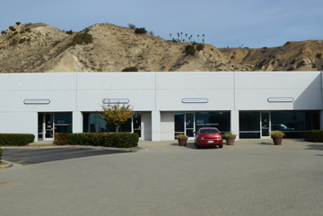
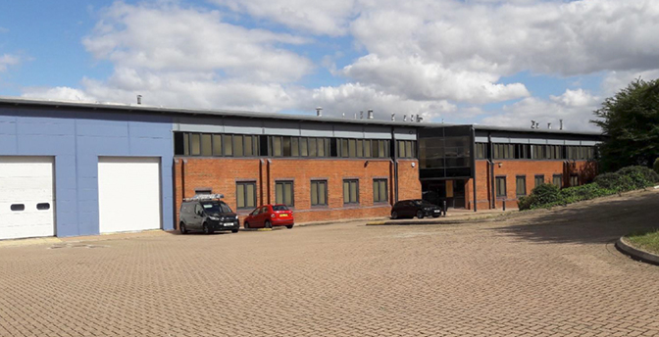
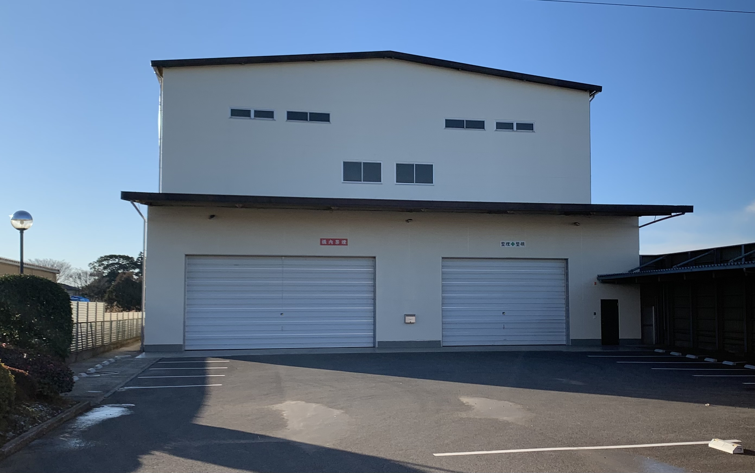
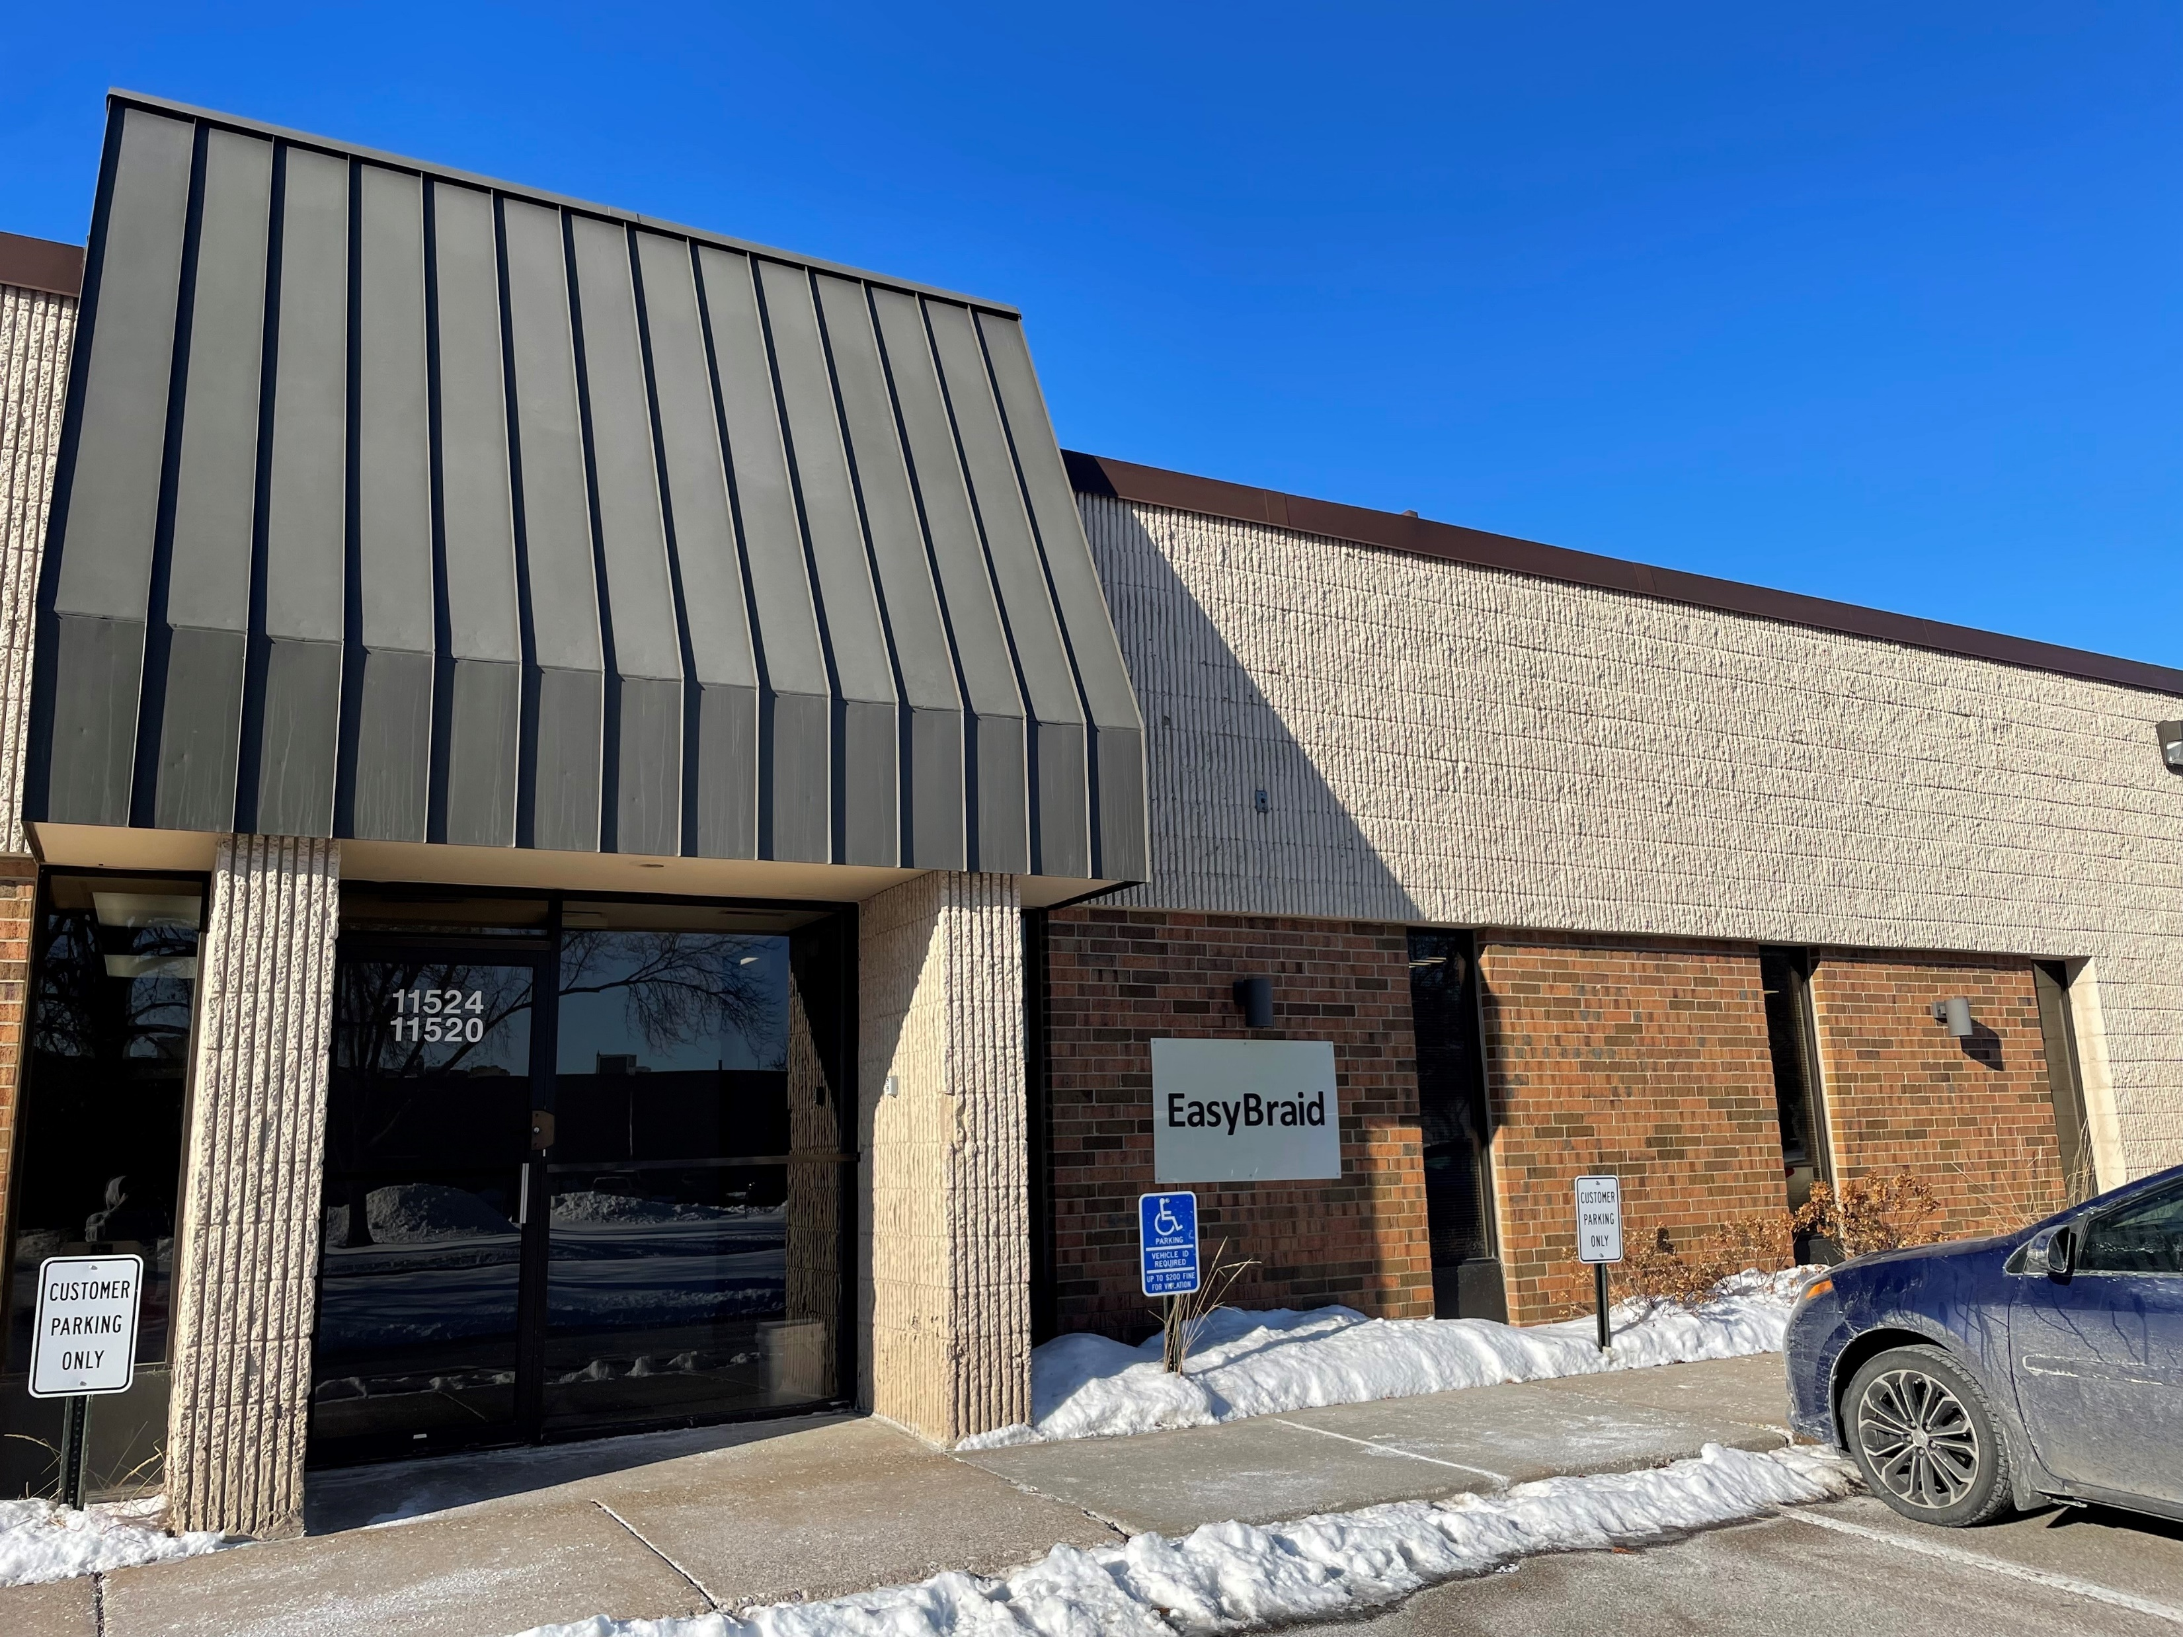
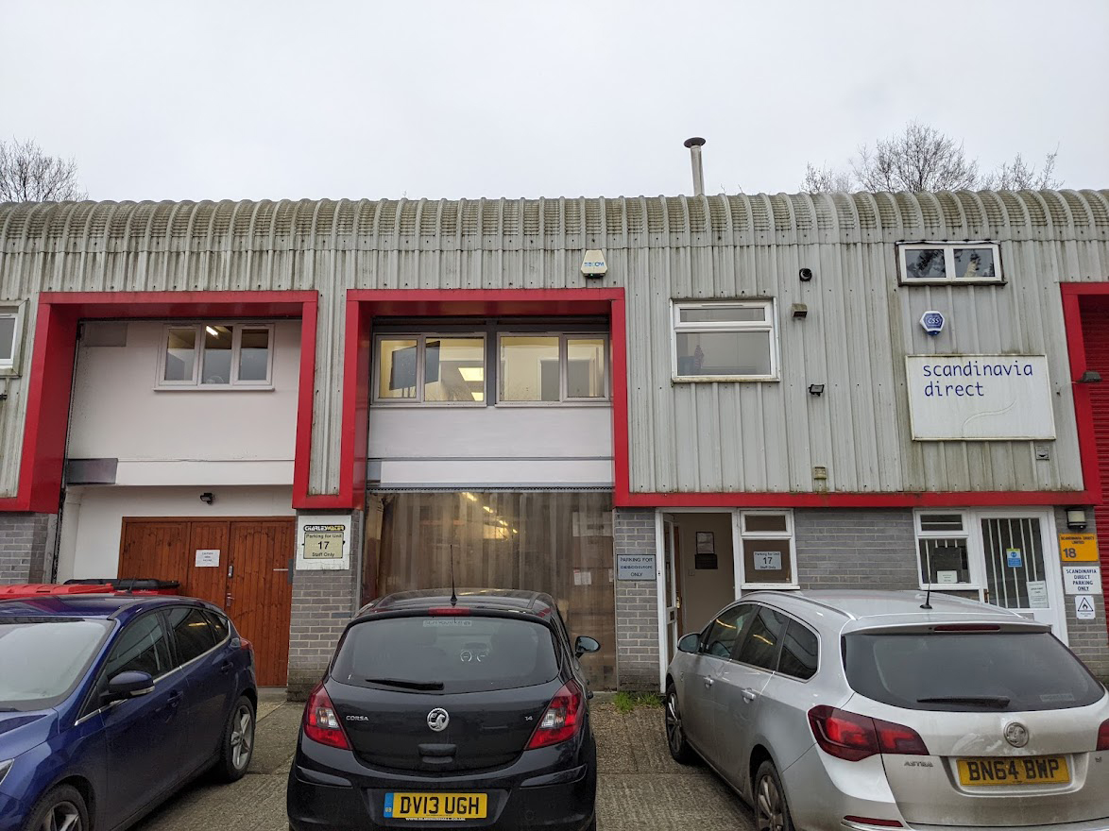
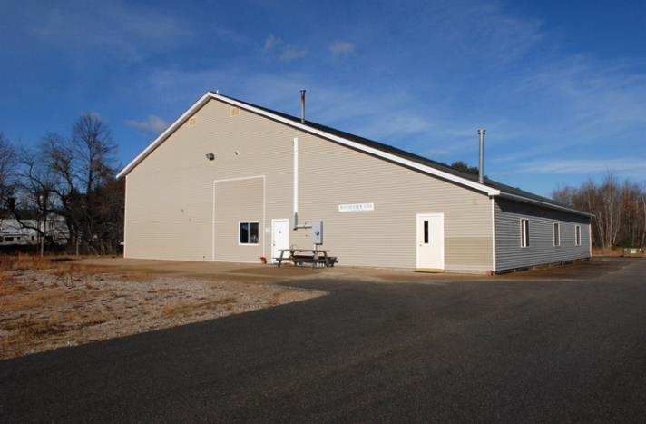
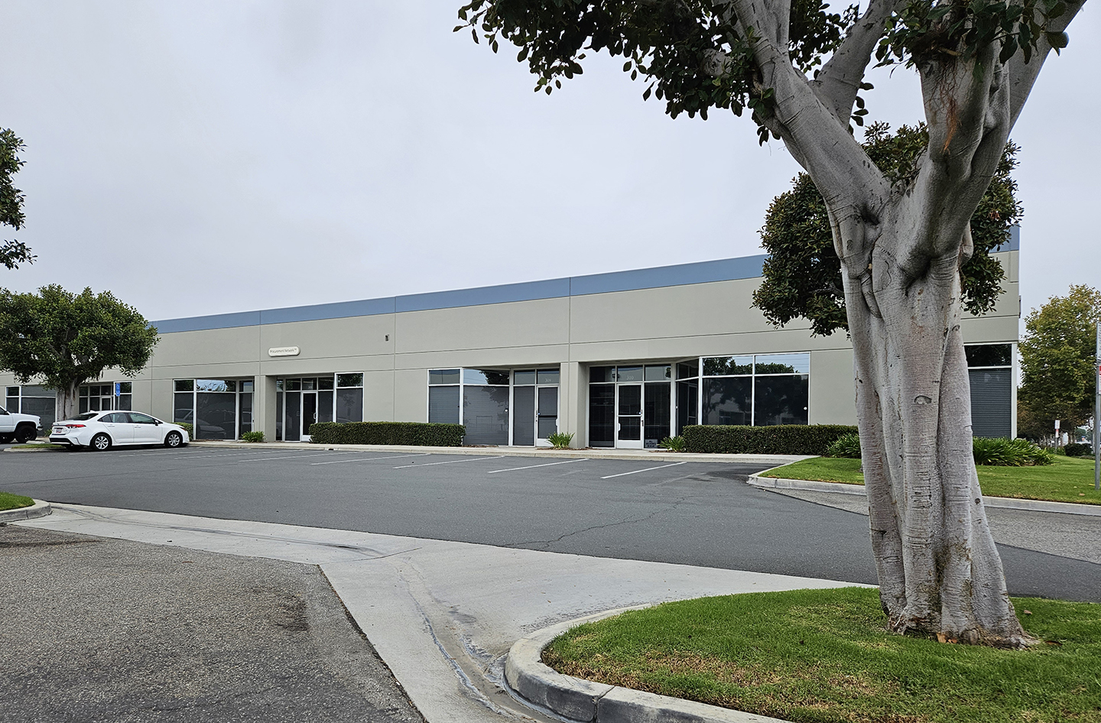
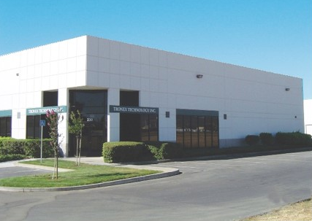
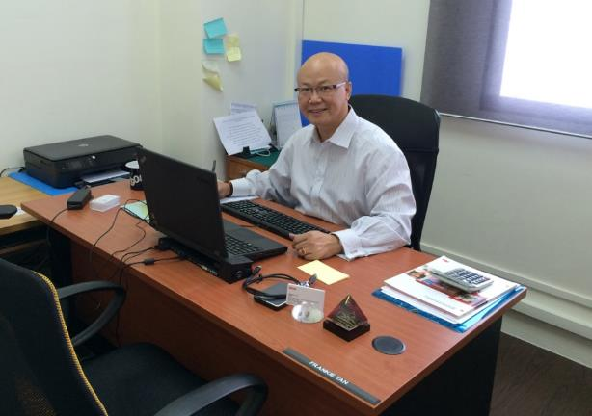
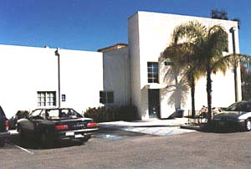
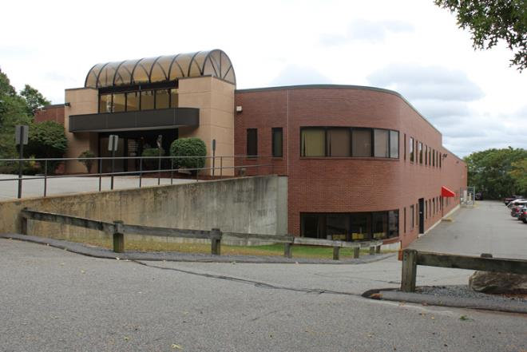
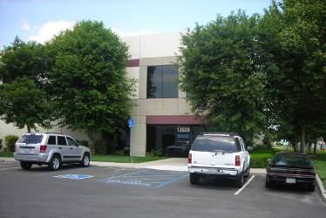
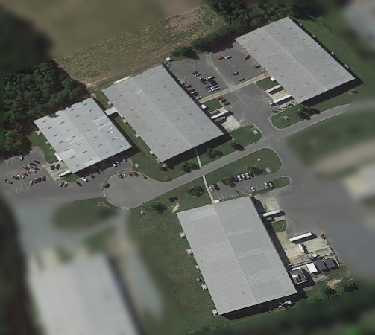
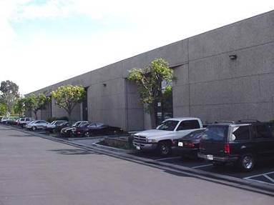
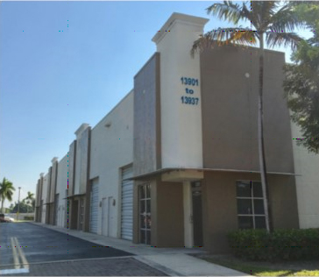
Locations
Minnetonka, MN
Letchworth, UK
Rochester, NH
Crowborough, UK
Fairfield, CA
Canton, MA
Santa Barbara, CA
Sanford, NC
Anaheim, CA
Yachimata City, Chiba, Japan
Chino, CA
Miami, FL
Yorba Linda, CA
Singapore
DescoIndustries.com

Slide 16
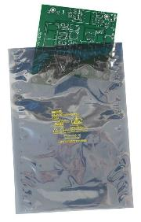
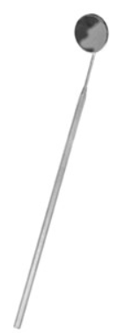
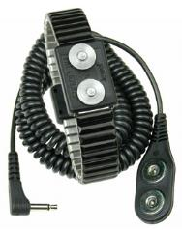
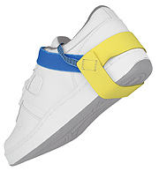
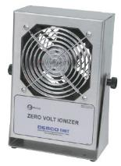
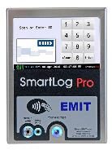
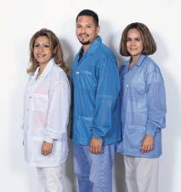
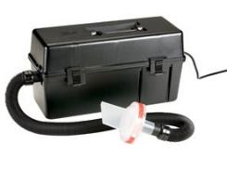
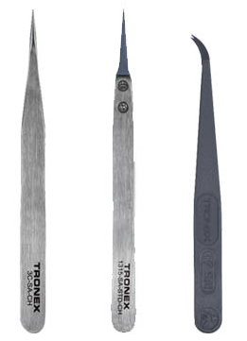

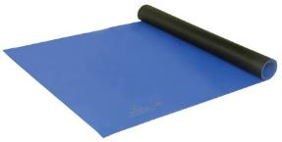
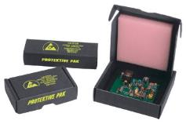
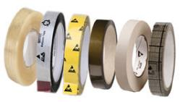


DESCO INDUSTRIES INC
Broadest Offering of ESD Control Solutions
DescoIndustries.com

Slide 17

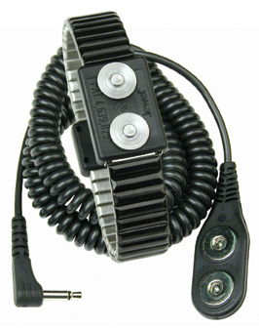
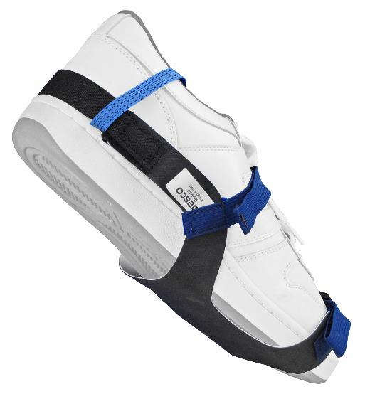
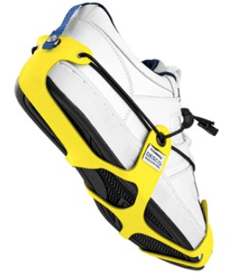
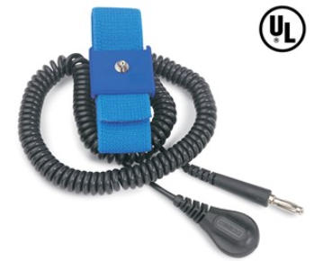

Broadest ESD Offering
Personnel Grounding - Wrist Straps, Foot Grounders, Ground Cords, multiple variations
Made in the United States of America
DescoIndustries.com

Slide 18
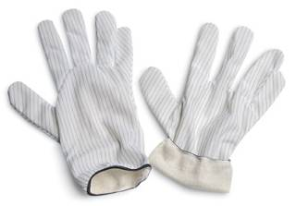
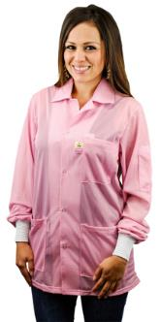
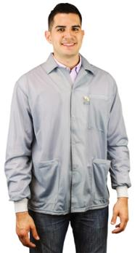
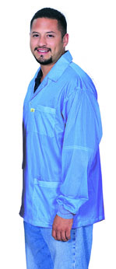
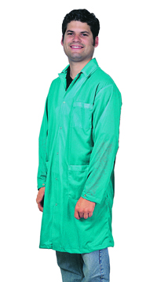
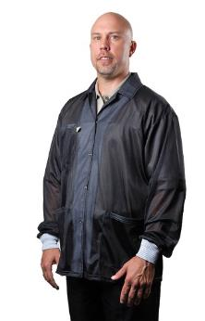
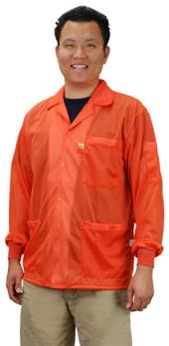
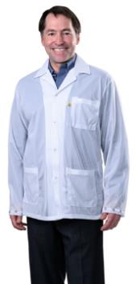
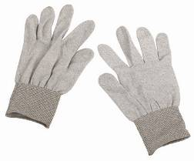
Broadest ESD Offering
Garments - Smocks, Gloves
Made in the United States of America
DescoIndustries.com

Slide 19
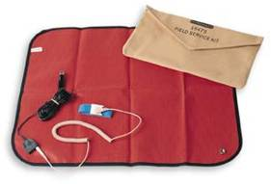
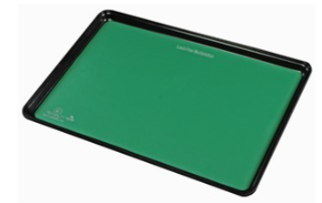
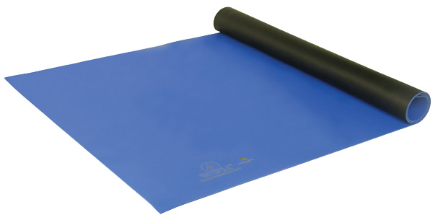
Broadest ESD Offering
Worksurfaces - Micastat, 2-layer Rubber, Homogeneous Vinyl, 3-Layer, field service
Made in the United States of America
DescoIndustries.com

Slide 20
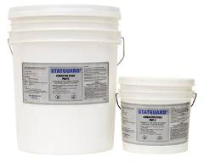
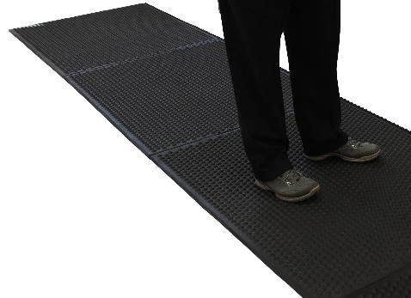
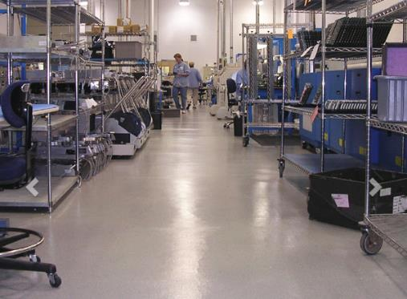
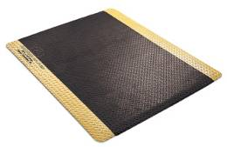
Broadest ESD Offering
ESD Flooring - Rolled Matting, Modular Anti-Fatigue, Floor Finish, Conductive Paint, Epoxy, Carpet Spray, VCT, Carpet, Rubber Tiles
Made in the United States of America
DescoIndustries.com

Slide 21
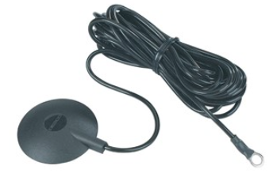
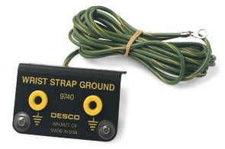
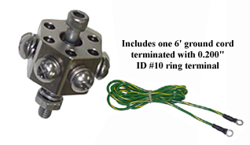
Broadest ESD Offering
Grounding Accessories & Tools
Made in the United States of America
DescoIndustries.com

Slide 22









Broadest ESD Offering
Test Equipment – ESD Event Meter, Data Acquisition, Continuous Monitors, Personnel Grounding Testers, Static Location, Surface Resistance Testers, Calibration & Verification.
Made in the United States of America
DescoIndustries.com

Slide 23





Broadest ESD Offering
Ionization - Overhead, Benchtop, Compressed air, Process Ionization, Room Ionization
Made in the United States of America
DescoIndustries.com

Slide 24






Broadest ESD Offering
Packaging, Coating, and Laminating - Static Shielding (including qualified to Mil-PRF-81705E Type III, Class 2), Moisture-Vapor-Barrier, Clear dissipative, Gusset, Unique Bag-In-Bag, Bags on roll, Vacuum Sealers
Made in the United States of America
DescoIndustries.com

Slide 25








Broadest ESD Offering
Packaging - Protective Pak packaging provides complete ESD and physical protection for static sensitive devices
Made in the United States of America
DescoIndustries.com

Slide 26




Broadest ESD Offering
ESD Tapes and Labels - Clear, Conductive Grid, Masking, Kapton, floor marking, Green labels
DescoIndustries.com

Slide 27







Broadest Offering
Specialty Products - Dispensers, Brushes, Portable Workstation Organizer, ESD Lotion, ESD Vacuum
DescoIndustries.com

Slide 28



Broadest Offering
Specialty Tools – Stainless Steel Probes, Spudgers Cable Ties, Sleeving Cutter, Wire Threader, Cleaning Brushes, Soldering Aids
DESCO 1st
Product
Made in the United States of America
DescoIndustries.com

Slide 29




Broadest Offering
Specialty Products - Soldering Stations and Equipment: Desoldering Braid, Stencil Rolls and Wipes, Solder Soakers, WickGun
DescoIndustries.com

Slide 30





Broadest Offering
Specialty Products – Hand tools: Cutters, Pliers, Strippers, Tweezers
DescoIndustries.com

Slide 31








Broadest Offering
Beauty Supplies – Pumps and Bottles, Aprons, Orange Sticks
DescoIndustries.com

Slide 32









Broadest Offering
Identification – Badge Holders, Badge Reels, Lanyards
Made in the United States of America
DescoIndustries.com

Slide 33






Broadest Offering
Thermal Management – AC and DC fans and blowers and related accessories, such as finger guards, filters, and fan cords

Slide 34



Broadest Offering
Clean Assembly and Packaging
DescoIndustries.com

Slide 35





Broadest Offering
Manufacturing outsourcing services and engineering support and design
DescoIndustries.com

Slide 36

In-House Training and
Customer Support
Factory Trained Technicians who can perform ESD training and support
Inside Sales team provides added support
NARTE Certified sales force
Product Management and marketing team provides additional expertise
DescoIndustries.com

Slide 37

Largest Manufacturer of ESD Products in the World
$78,300,000 in Revenues
USA Manufacturer with factories in Chino, CA;
Yorba Linda, CA; Anaheim, CA, Santa Barbara, CA; Fairfield, CA; Canton, MA; Sanford, NC; Rochester, NH; Miami, FL; Minnetonka, MN; Letchworth, UK; Yachimata, Japan
World’s largest inventory of ESD Products: Chino, CA; Santa Barbara, CA; Canton, MA; Sanford, NC; Rochester, NH; Crowborough, UK; Letchworth, UK; Yachimata City, Chiba, Japan
Partnered with world class suppliers, including: Berry Plastics Corporation, Polyplex USA LLC, American Biltrite Ltd, Chemprene Inc, Pandel Inc, Simco Ion Technology Group, etc.
Financial and Human Resource Support for Growth
DescoIndustries.com

Slide 38
DII Market Driven Strategies
Multiple channels to address fragmented
market place:
Full Service ESD Solutions provider - Sells through distribution, reps, iNARTE Certified factory personnel
e-Comm driven - Broadens our reach to increase demand
European and Asian focus, support globalization of
customer base
DescoIndustries.com

Slide 39

Marketing Focus
Continued focus on SEO for lead acquisition
Update technical content for continued use as a resource for ESD knowledge
Promote value added services provided by the individual brand
Videos for product instructions, features and general use
Webinar platform for training
DescoIndustries.com

Slide 40

Value of the Brand
Establishes brand equity, adds value beyond the generic service or product benefit.
Makes an intangible product or service more tangible, allows differentiation.
Increases long-term sustainability. Any product can be copied, but a brand cannot.
Better corporate vision and mission. Provides clear principles to guide management decision.
Consistency - both internally and to customers.
Provides platform for future service or product developments.
DescoIndustries.com

Slide 41
Product Trademarks
Charge-Guard®
Reztore®
Dri-Shield®
Statguard®
durAstatic®
Statfree®
EasyBraid®
Statshield®
Iron Man®
Chargbuster®
Jewel®
Trustat®
Magsnap®
Micastat®
SmartLog Pro®
Razor Flush®
DescoIndustries.com

Slide 42


Product Brands
durAstatic®
DescoIndustries.com

Slide 43




Product Brands
Personnel and Mat Grounding, Test Equipment
Trustat™
Jewel®
ErgoBand®
Ion Pro™
SmartLog Pro®
DescoIndustries.com

Slide 44




Product Brands
Packaging & Personnel Grounding
Statshield®
Protektive Pak®
AutoShield™
Dri-Shield®
DescoIndustries.com

Slide 45

Product Brands
Production Tools
Circuitracer®
DescoIndustries.com

Slide 46



Web Sites
Desco
SCS
MENDA
MendaBeatuy
Protektive Pak
APR
Tronex
Statguard Flooring
Desco Asia
Desco Japan
Desco Europe
SpecialTeam
ESDSystems.com
USToyoFan
proNet
DescoIndustries.com

Slide 47

Web site Features
e-Commerce shopping cart
24/7/365 service/support
On-line stock check and pricing
Qualification Test Reports
Guest Checkout
Responsive design
Listing of Reps & Distributors
New Products
Promotions
Package Tracking System
Technical Bulletins & Drawings
Newsletters / Training
DescoIndustries.com

Slide 48

Who Is Desco Industries
DescoIndustries.com

Slide 49

DII Family of Companies...
... is focused on growth, expansion, & profit!
DescoIndustries.com

